Slide 1



Ministry of Communications and Information Technology Digital Egypt Pioneers Initiative
GOOGLE PROJECT MANAGEMENT TRACK
GRADUATION PROJECT
Project Management Pioneers Team

Slide 2

CONTENTS
Project initiating & Define Phase
Measure Phase for the project
Analysis Phase for the project
Control & Closing Phase for the project
Improve Phase for the project

Slide 3
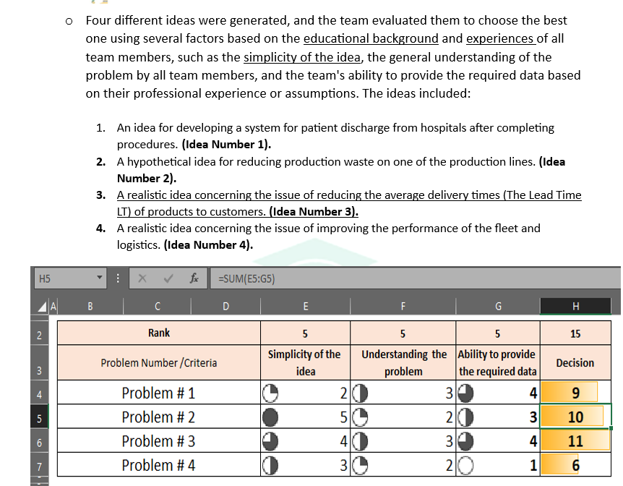

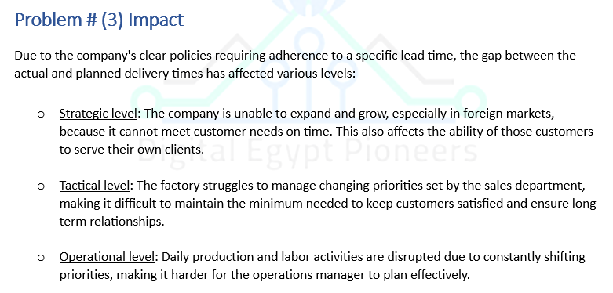
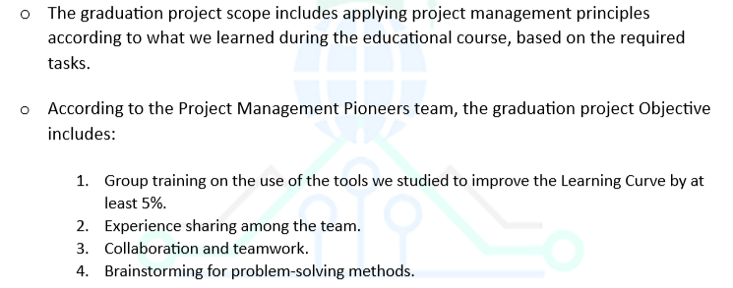
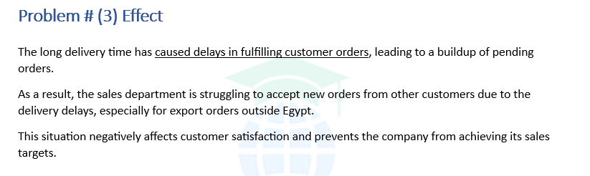
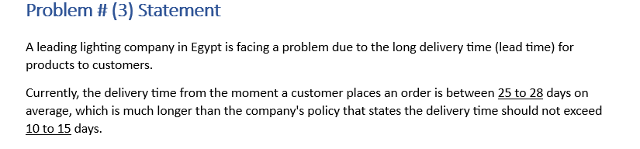
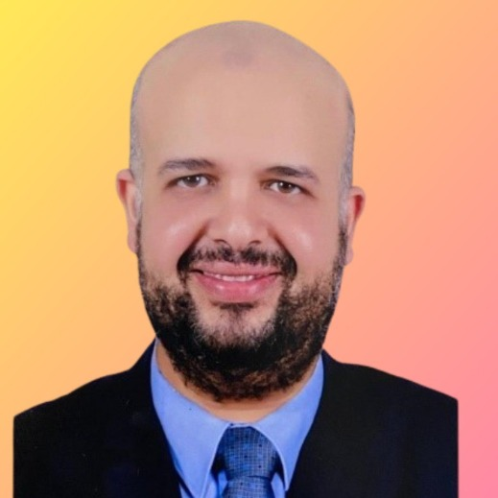
Policy, Agreement & Overview
On September 7, 2024, the team created a WhatsApp group to collaborate on the project.
Thanks and appreciation
Track Overview
Our graduation project Scope & Objective
Inquiry | Details
Round Number | 1
Track Name | Google Project Management
Instructor's Name | Dr. Haitham Salem
WhatsApp Group Code | NEXT73 _CAI1_ERP8_M1e
Provider | Next Academy
Number of Project Group Members | 5
Project Group Name | Project Management Pioneers
Project Management Pioneers (The team) Policy
Problem # (3) Statement
Problem # (3) Effect
Problem # (3) Impact

Slide 4
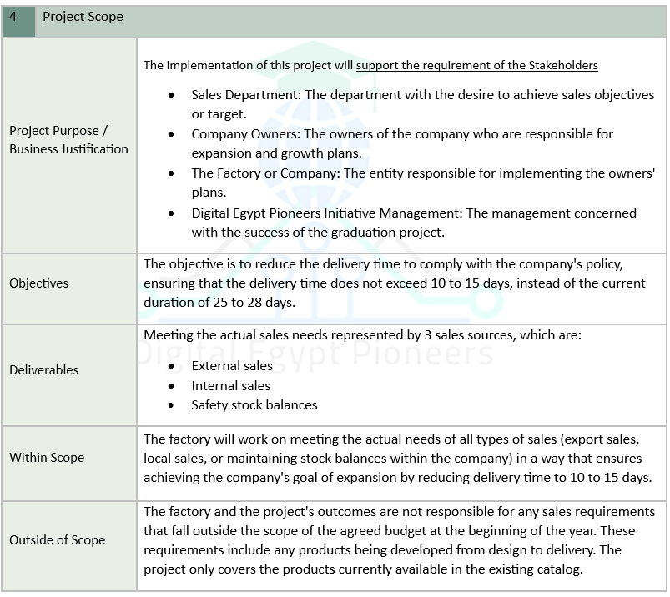
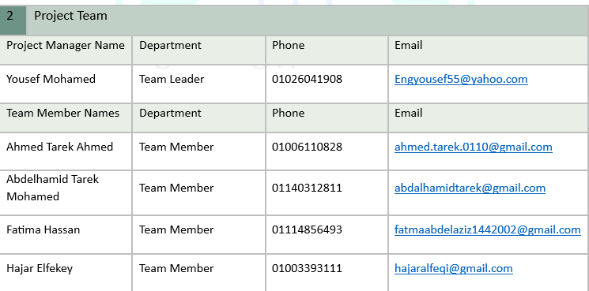
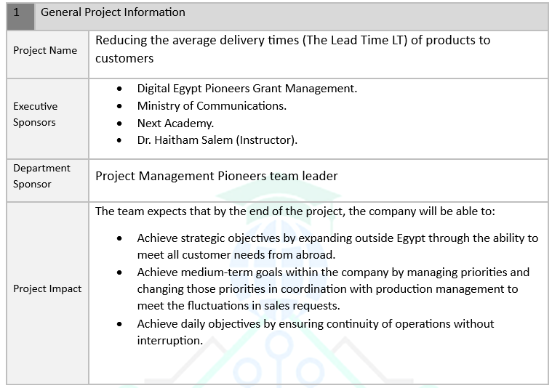
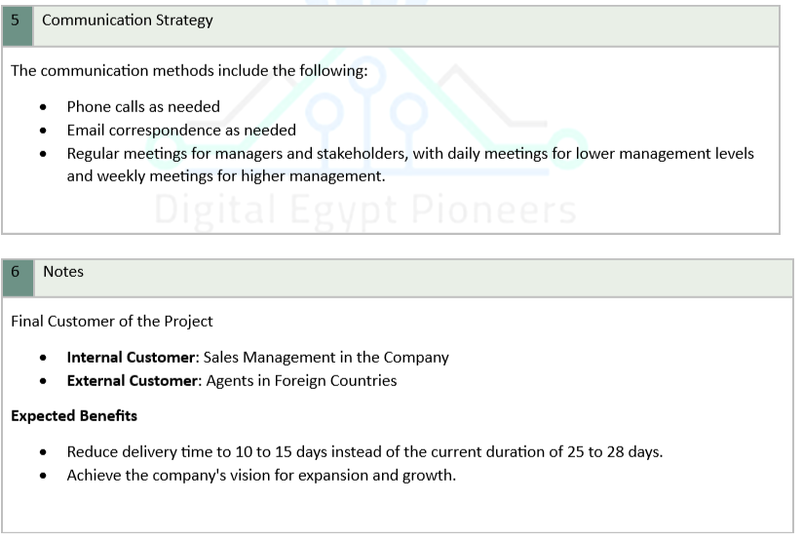
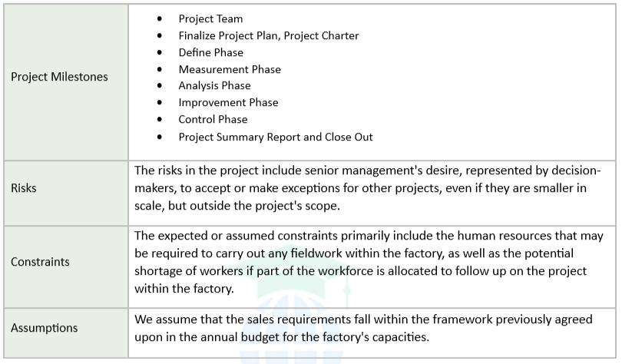
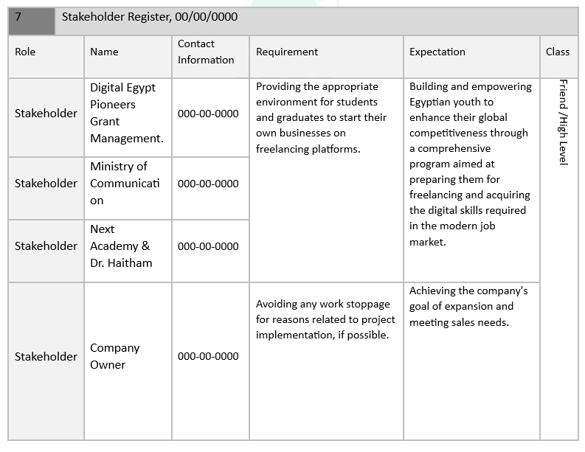
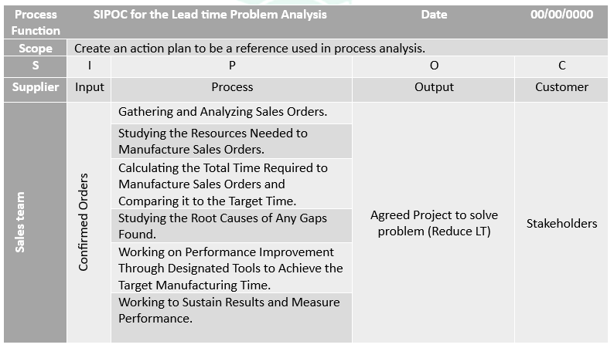
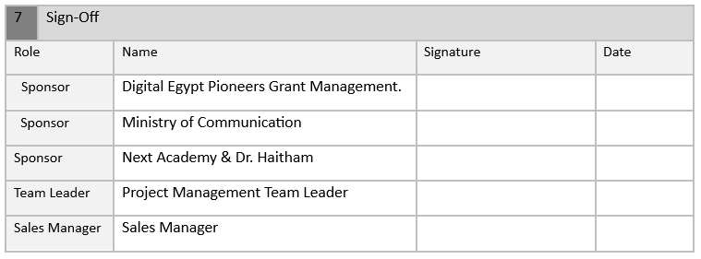
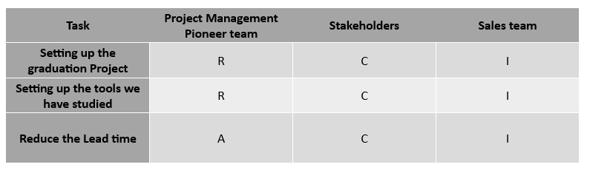
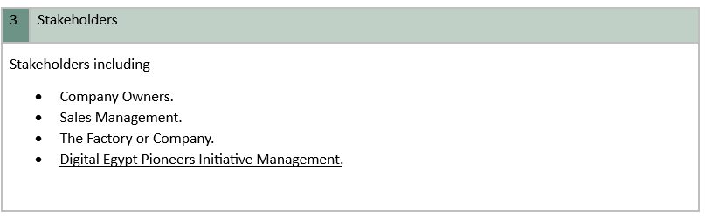
Project initiating & Define Phase
Problem # (3) Project Charter
Problem # (3) Stakeholder Register
Problem # (3) RACI Matrix
Problem # (3) SIPOC

Slide 5
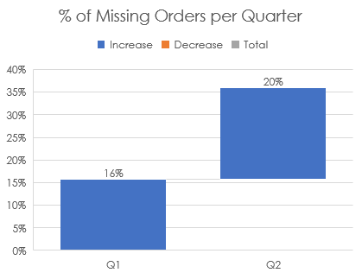
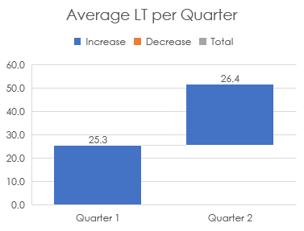
Month # | Week # | Total Order received | Perfect Orders | Missed Orders | Actual Lead time (Days)
1 | 1 | 18 | 15 | 3 | 28
 | 2 | 15 | 15 | 0 | 25
 | 3 | 14 | 10 | 4 | 26
 | 4 | 16 | 13 | 3 | 24
2 | 1 | 10 | 8 | 2 | 25
 | 2 | 12 | 9 | 3 | 26
 | 3 | 18 | 16 | 2 | 28
 | 4 | 22 | 18 | 4 | 29
3 | 1 | 23 | 20 | 3 | 27
 | 2 | 20 | 15 | 5 | 20
 | 3 | 18 | 17 | 1 | 20
 | 4 | 12 | 9 | 3 | 26
4 | 1 | 10 | 6 | 4 | 24
 | 2 | 15 | 10 | 5 | 22
 | 3 | 18 | 14 | 4 | 28
 | 4 | 16 | 15 | 1 | 27
5 | 1 | 14 | 12 | 2 | 24
 | 2 | 15 | 13 | 2 | 28
 | 3 | 13 | 10 | 3 | 26
 | 4 | 11 | 8 | 3 | 27
6 | 1 | 11 | 7 | 4 | 25
 | 2 | 16 | 14 | 2 | 28
 | 3 | 17 | 15 | 2 | 29
 | 4 | 16 | 12 | 4 | 29
Measure Phase for the project
Problem # (3) Data Collection
Problem # (3) Data Analysis & Dashboard

Slide 6
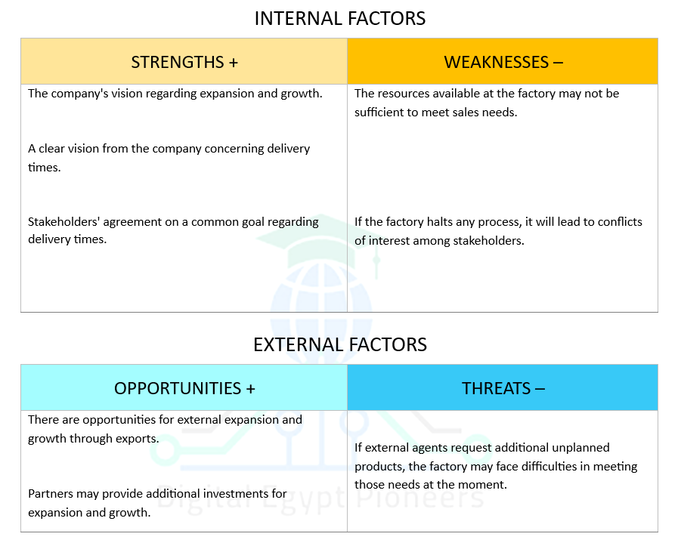
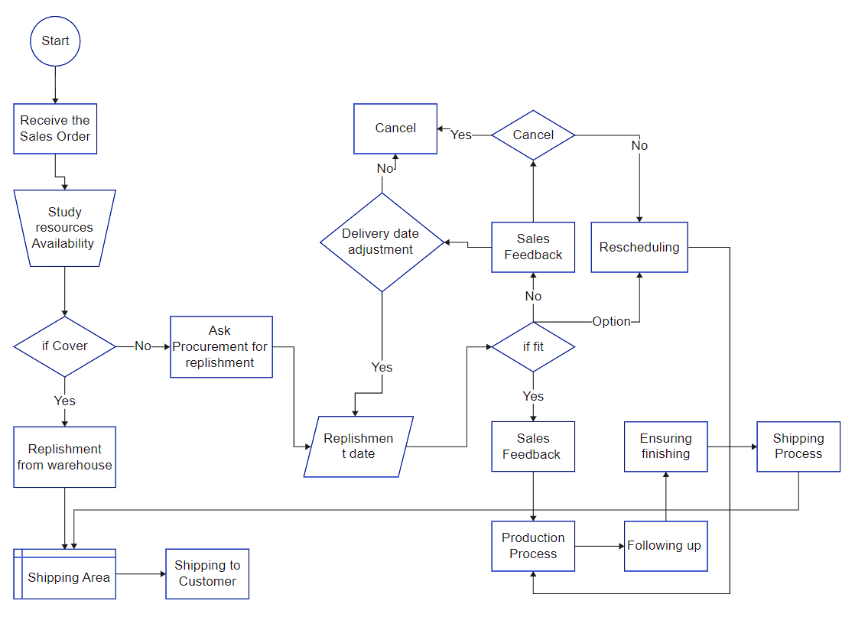
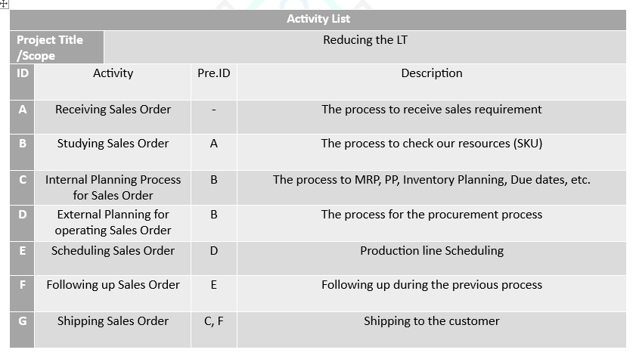
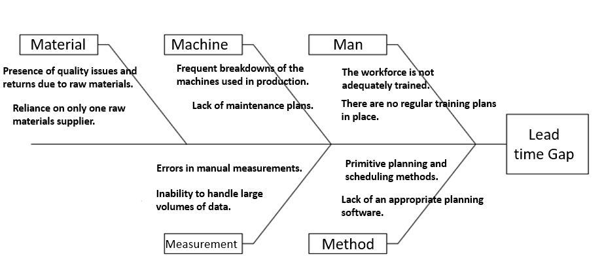
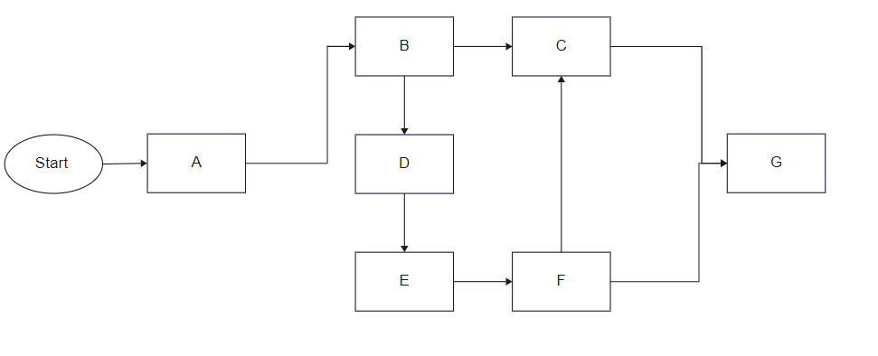
Analysis Phase for the project
Problem # (3) Fishbone Diagram
Problem # (3) SWOT Analysis
Problem # (3) Flow Chart for Process
Problem # (3) Activity List
Problem # (3) Activity Diagram

Slide 7
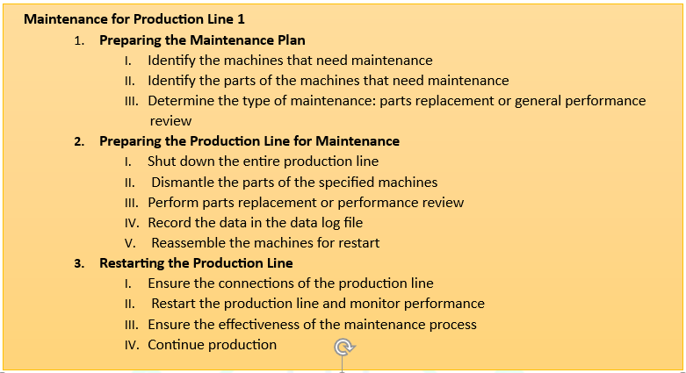
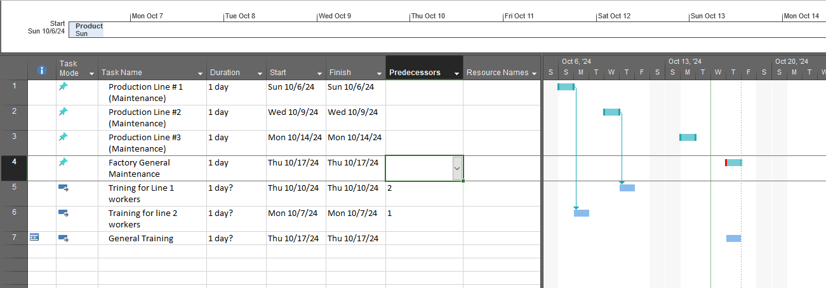
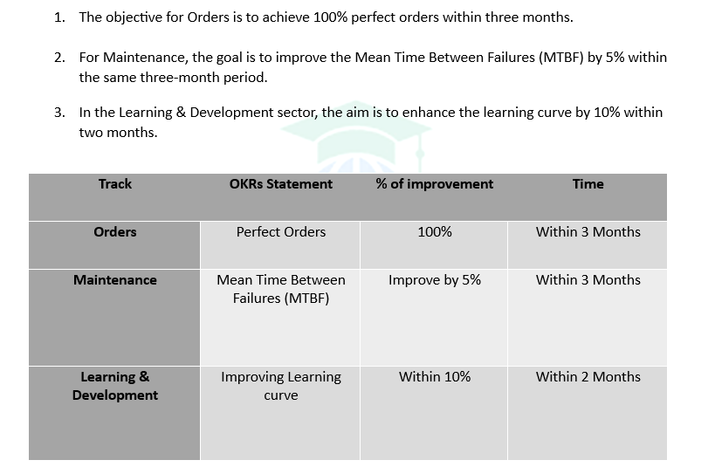
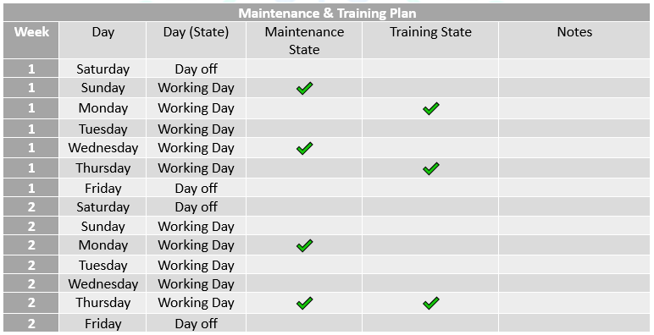
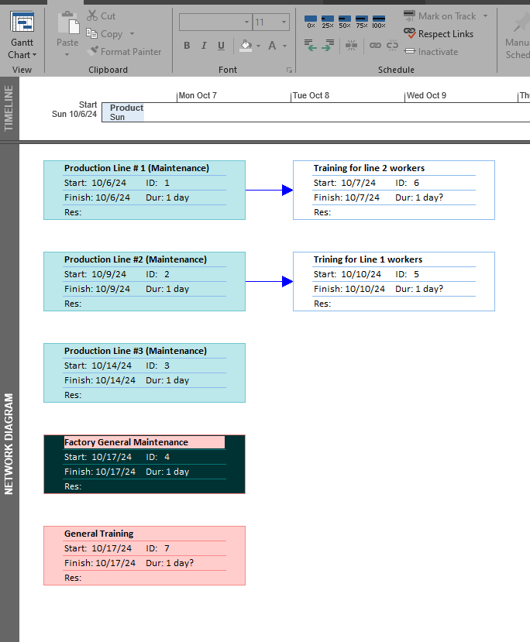
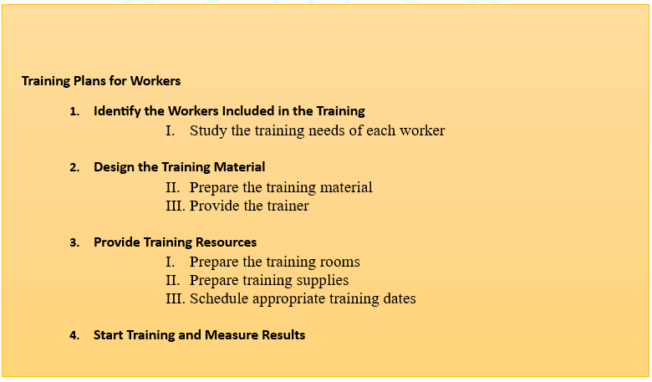
Improve Phase for the project
Problem # (3) Theory of constrain
Problem # (3) Gantt Chart
Problem # (3) Net Work Diagram
Problem # (3) Work Breakdown Structure
Problem # (3) Objectives and Key Results (OKRs)

Slide 8
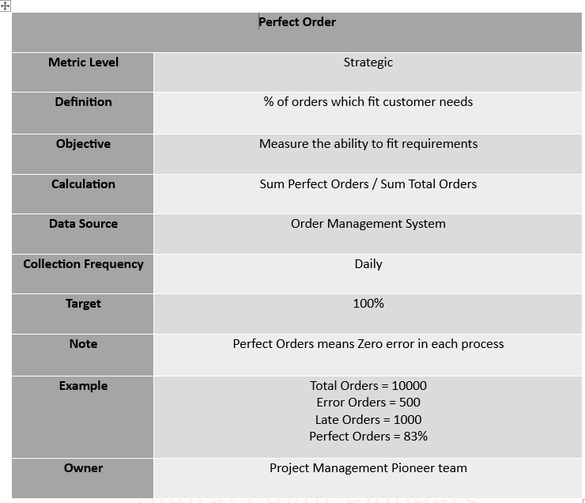
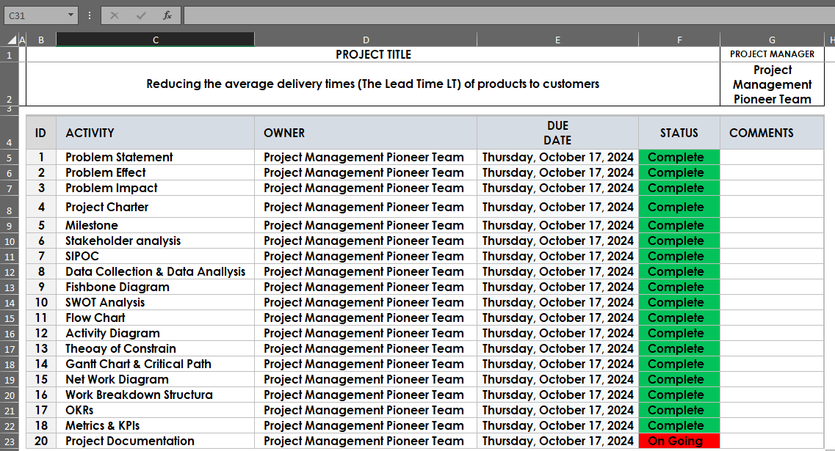
Control & Closing Phase for the project
Problem # (3) Setting Metrics & KPIs
Problem # (3) Closing Project

Slide 9
THANK YOU
Project Management Pioneers Team

